Slide 1

FAKE NEWS CLASSIFICATION & PREDICTION
DATA 606 CAPSTONE PROJECT
Under guidance of Prof. Dr. Chaojie Wang
BY:
SUSHRUTH DT
SRIKEERTHI UPPERLA

Slide 2


INTRODUCTION
The World Economic Forum ranks the spread of misinformation and fake news, as among the world’s top global risks.
You deserve the truth
False news erodes credibility
Fake news can harm you and others o
Real news can help

Slide 3
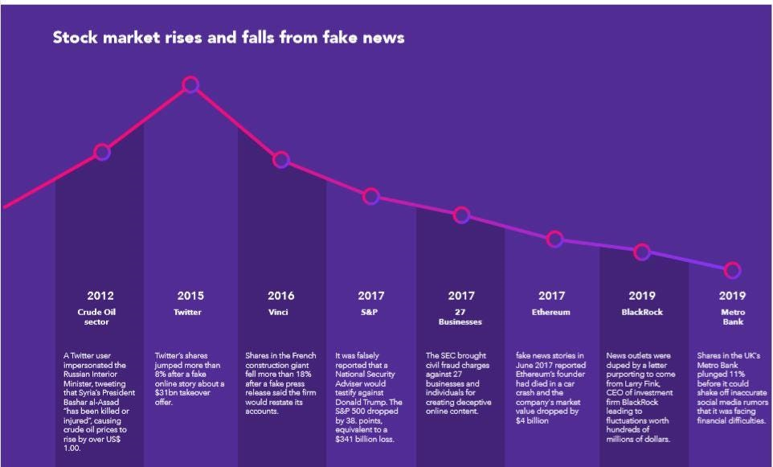


Slide 4

ABOUT THE DATASET
Size of the dataset : 123.81 MB
Shape of the dataset : (20800, 5)
train.csv: A full training dataset with the following attributes:
id : unique id for a news article
title: the title of a news article
author: author of the news article
text: the text of the article; could be incomplete
label: a label that marks the article as potentially unreliable
1: unreliable
0: reliable
test.csv: A testing training dataset with all the same attributes at train.csv without the label.
submit.csv: A sample submission

Slide 5

RESEARCH QUESTIONS
I would mostly like to concentrate on – title, author and text from the dataset.
Title and Text:
Does all the fraudulent news have repetitive jargon? Is there a pattern? What keywords are highly used in fake news?
Author:
Are most of the fake news generated by the same author? Is there a pattern? Predict if the following edition of the author would be fake.

Slide 6
RESEARCH QUESTIONS
Distinguish between Accurate news and Fake news.
Our research investigates various textual properties that can be used to distinguish between Fabricated and Authentic content.
It is our goal to distinguish between fake and true news by developing powerful classification models for the news data we have gathered so far.
Spot if next submission of author is fake or
Extensive EDA of news
Suspicious titles that can be tagged to fake

Slide 7
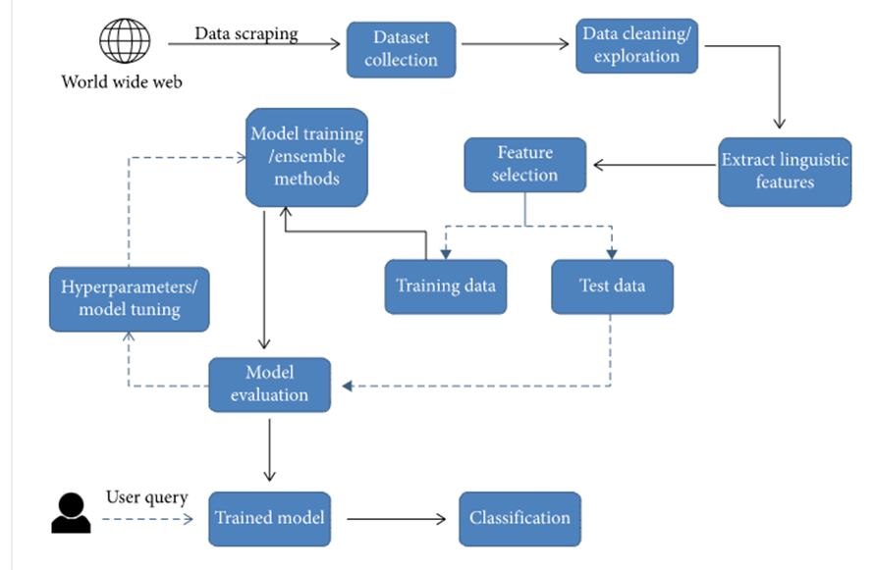
STEPS INVOLVED

Slide 8
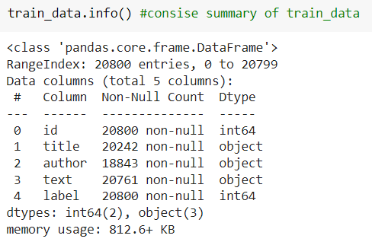
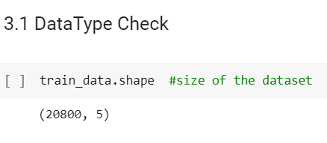
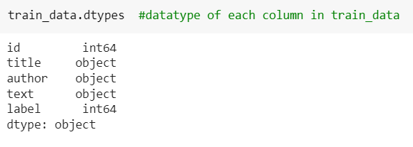
INITIAL EDA RESULTS:
We observed that Datatypes of columns are as expected. Therefore, there is no need to change data type

Slide 9
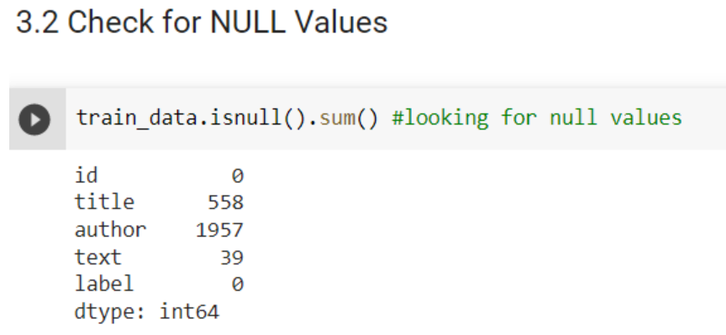
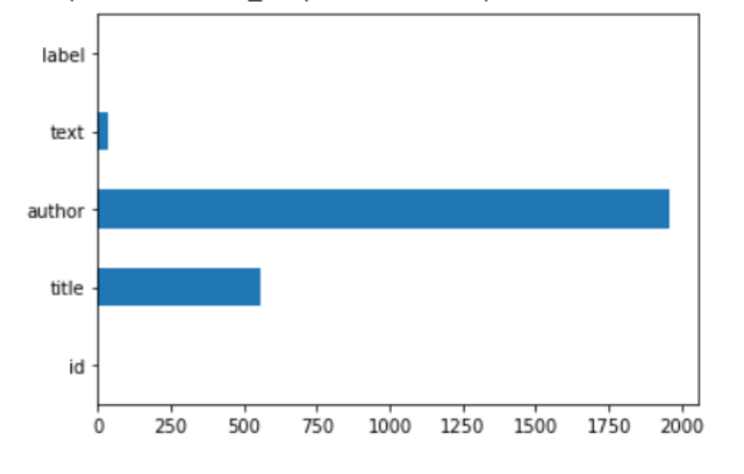
ii. Null Check

Slide 10
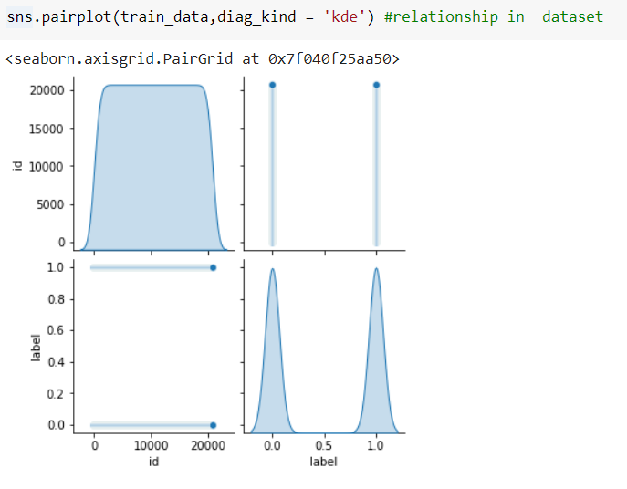
iii. Data Distribution

Slide 11
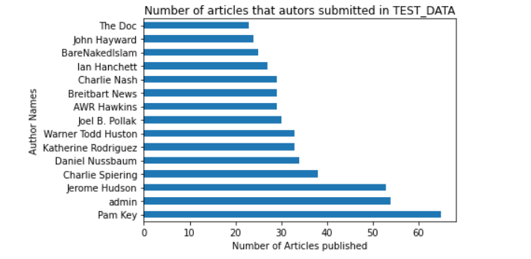
iv. Number of Article that authors submitted in TEST_DATA

Slide 12
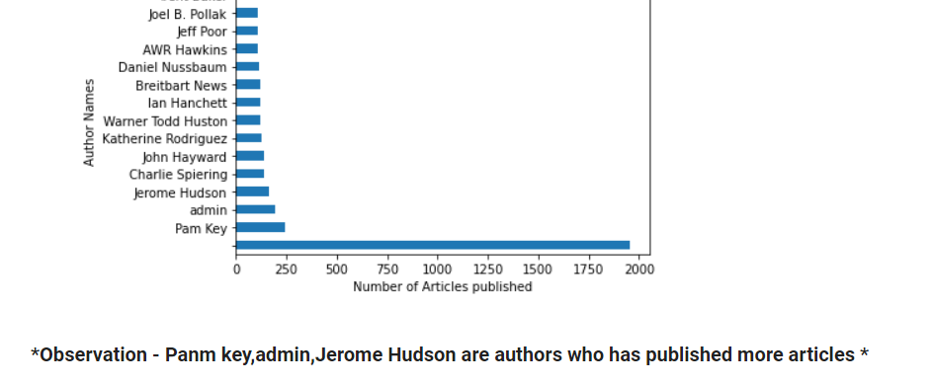
v. Number of Article that authors submitted in TRAIN_DATA

Slide 13
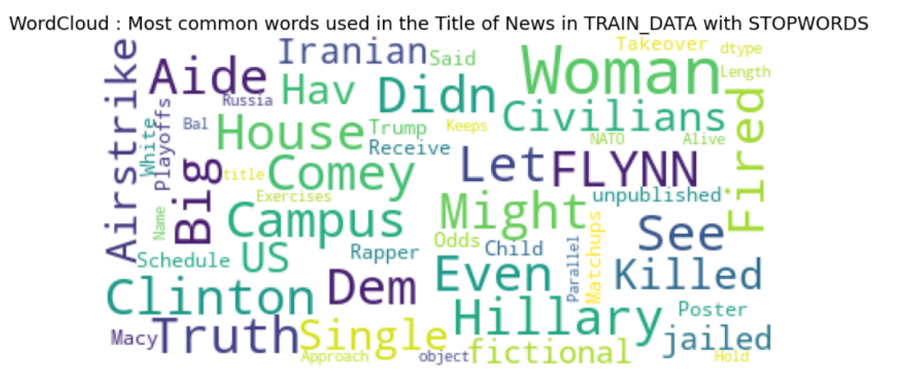
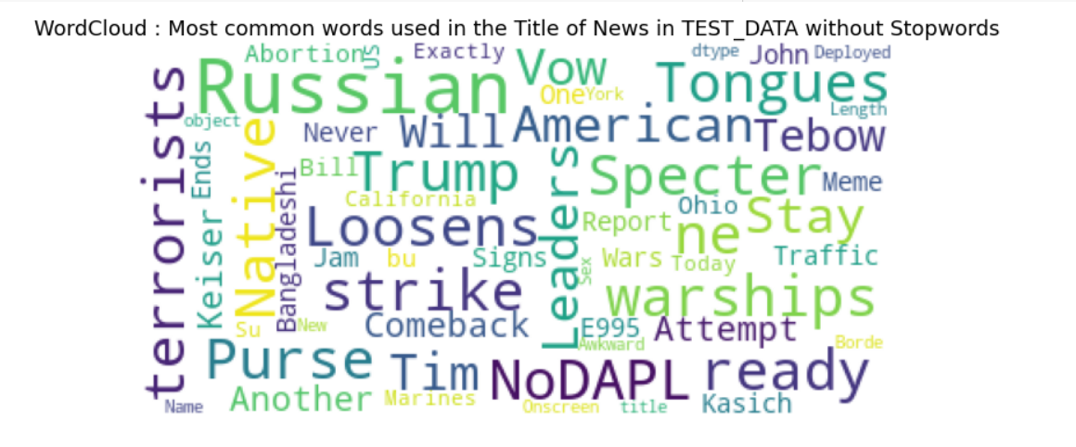
vi. Most Common words

Slide 14

MACHINE LEARNING MODELS
The sensationalism of not-so-accurate but eye-catching and intriguing headlines to retain audiences' attention to sell news has persisted throughout all sorts of information broadcast history, which, as conferred above, has many muted issues; thus, we would like to classify and predict fake news for which I plan to use the following models:
Logistic Regression
Multinomial Naïve Bayes
Passive aggressive classifier
Support Vector Machine
Decision Trees
KNN

Slide 15

EXPECTED OUTCOMES
This project aims to develop a solution that users can utilize to detect and filter out news containing false and misleading information. The plan is to carefully select features to identify fake posts/news.

Slide 16
REFERENCES
https://towardsdatascience.com/fake-news-detection-with-machine-learning-using-python-3347d9899ad1

Slide 17


